Slide 1

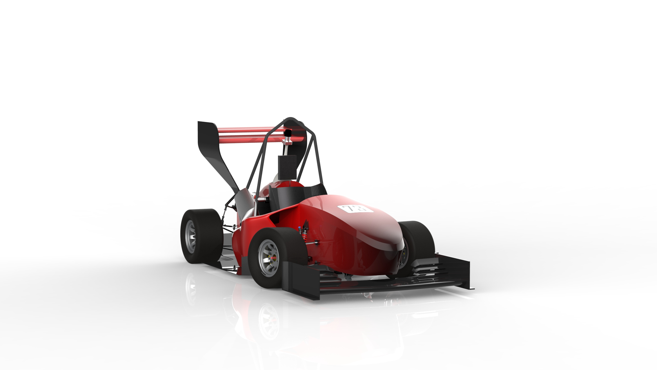
Low Voltage

Slide 2
Data Acquisition System

Slide 3
What is New?!

Slide 4
DAQ system implementation using RTOS:
What are the benefits?
The whole old system is divided into several tasks.
More Portable.
More Structured.
More Expandability.
More reliable.
Easy to find bugs and debug.

Slide 5
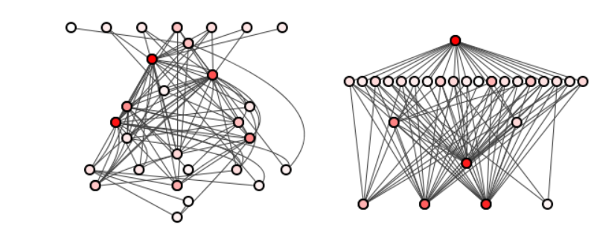

Slide 6
System Tasks
Task1: VehicleGetSteeringAngle()
Task2: IndProximity_MainFunction()
Task3: VehicleGetTravelReading()
Task4: VehicleGetSpeed()
Task5: VehicleGetImuData()
Task6: VehicleCanTransmitAllData()

Slide 7
System Static Analysis

Slide 8
Task | Periodicity(ms) | Execution Time | Deadline(ms) | Priority
VehicleGetSteeringAngle() | 5 | 1.25(us) | 5 | 6
IndProximity_MainFunction() | 5 | 0.1857(ms) | 5 | 5
VehicleGetTravelReading() | 10 | 6.5(us) | 10 | 4
VehicleGetSpeed() | 20 | 5.75(us) | 20 | 3
VehicleGetImuData() | 10 | 3.983(ms) | 10 | 2
VehicleCanTransmitAllData() | 20 | 1.178(ms) | 20 | 1

Slide 9
What about the interrupts over head?
The Inductive proximity sensor uses interrupt In Input capture unit.
The maximum ICU interrupt frequency is 200Hz (4 channels).
Serving ICU’s ISR Takes around 15(us)
Within the hyper period there is 16 ICU interrupt.
The total time consumed to serve ICU’s ISR within the one tick 60(us) (4 * 15).
We can divide this overhead time evenly over all task (60 /6 = 10us).
We can add 40us as an additional unexpected over heads.
So, a 50(us) is added for each to task’s execution time.

Slide 10
Task | Periodicity(ms) | Execution Time | Deadline(ms) | Priority
VehicleGetSteeringAngle() | 5 | 51.25(us) | 5 | 6
IndProximity_MainFunction() | 5 | 0.2357(ms) | 5 | 5
VehicleGetTravelReading() | 10 | 65.5(us) | 10 | 4
VehicleGetSpeed() | 20 | 55.75(us) | 20 | 3
VehicleGetImuData() | 10 | 4.033(ms) | 10 | 2
VehicleCanTransmitAllData() | 20 | 1.228(ms) | 20 | 1

Slide 11
Important Parameters
Scheduler type:
Fixed priority preemptive Scheduler.
System tick(OS tick) = 5 (ms).
System Hyper period LCM(I) = 20 (ms).
CPU load = 53.14%

Slide 12
System Schedulability
(Time demand analysis)

Slide 13
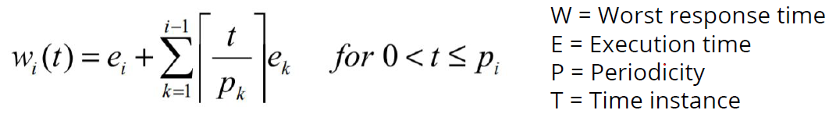
Applying Time Demand analysis for each Task to check for its Schedulability using this formula:

Slide 14
VehicleGetSteeringAngle():
w(5) = 51.25(us) w(20) < D (Feasible)
IndProximity_MainFunction():
w(5) = 0.2357 + (5/5)* 0.05125= 0.28695(ms) w(5) < D (Feasible)
VehicleGetTravelReading():
w(10) = 0.0655 + (10/5)* 0.05125 + (10/5)* 0.2357 = 0.6394(ms) w(10) < D (Feasible)

Slide 15
VehicleGetSpeed():
w(20) = 0.05575 + (20/5)* 0.05125 + (20/5)* 0.2357 + (20/10)* 0.0655 = 1.33455(ms) w(20) < D (Feasible)
VehicleGetImuData():
w(10) = 4.033 + (10/5)* 0.05125 + (10/5)* 0.2357 + (10/10)* 0.0655 + (10/20)* 0.05575 =5.4233(ms) w(10) < D (Feasible)
VehicleCanTransmitAllData():
w(20) = 1.228 + (20/5)* 0.05125 + (20/5)* 0.2357 + (20/10)* 0.0655 + (20/20)* 0.05575 + (20/10)* 4.033 = 10.62855(ms) w(20) < D (Feasible)
The system over all is 100% feasible.

Slide 16
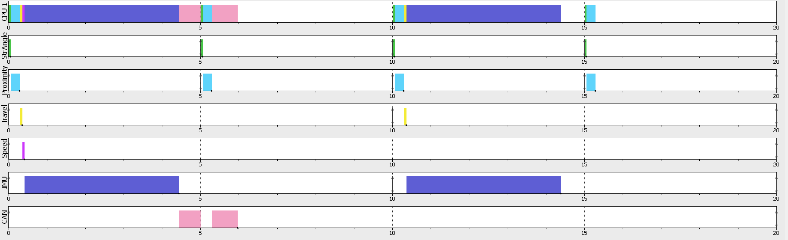

Slide 17
CAN Handling

Slide 18
System Messages
The whole system consists of 5 CAN messages:
CanMessageWheelsRPM:
2 bytes (FR Rpm), 2 bytes (Fl Rpm), 2 bytes (RR Rpm), 2 bytes (RL Rpm).
CanMessageIMUxy:
2 bytes (Ax), 2 bytes (Ay), 2 bytes (Gx), 2 bytes (Gy).
CanMessageSusTravel:
1 byte (FR Travel), 1 byte (Fl Travel), 1 byte (RR Travel), 1 byte (RL Travel).

Slide 19
CanMessageIMUzRollPitch:
2 bytes (Az), 2 bytes (Gz), 2 bytes (Roll), 2 bytes (Pitch).
CanMessageStrAngle_Speed_TimStamp:
2 bytes (Steering Angle), 1 byte (Speed), 2 bytes (CAN Time Stamp), 2 bytes (System Time Stamp).
All CAN Messages are sent as one block periodically with rate of 50Hz.

Slide 20
Another Way for
CAN Handling

Slide 21
FreeRTOS queues
We Can use queues as follows:
Getting A new Data.
Putting the data into the queue.
This action notifies CAN Task to start sending the new data.
There a new message sent whenever a new data put in the Queue

Slide 22
Wheel Speed Module

Slide 23
ISR Handling
ICU’s ICR all its work is just storing Rising egad capture timing for the 4 ICU channels.
Events group is used in the ISR For notifying the main inductive proximity tasks.
Each channel Notifies the main task if there is a new value captured.
After a slice of time if there is No New captured value so the 4 wheels’ RPM and the Vehicle speed return to Zero.

Slide 24
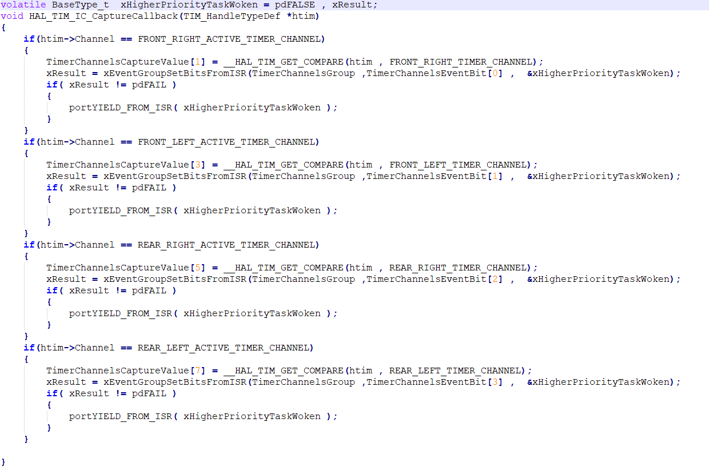

Slide 25
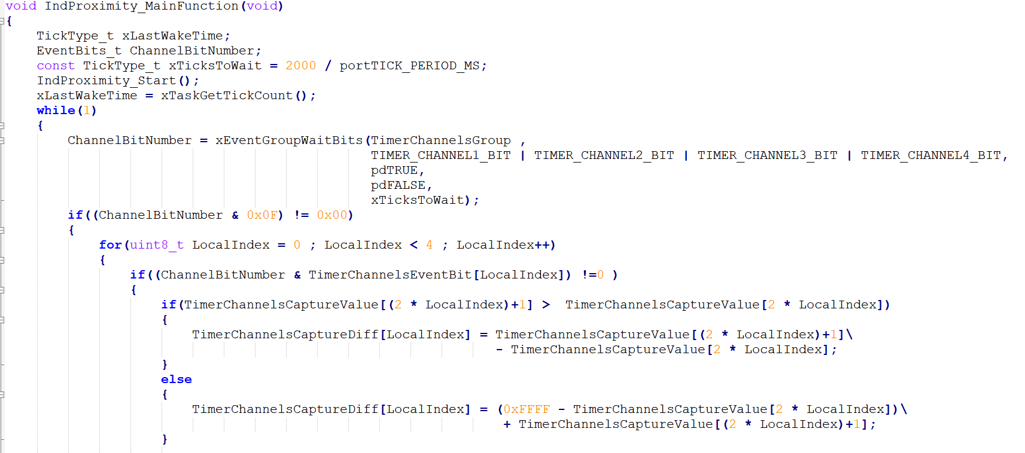
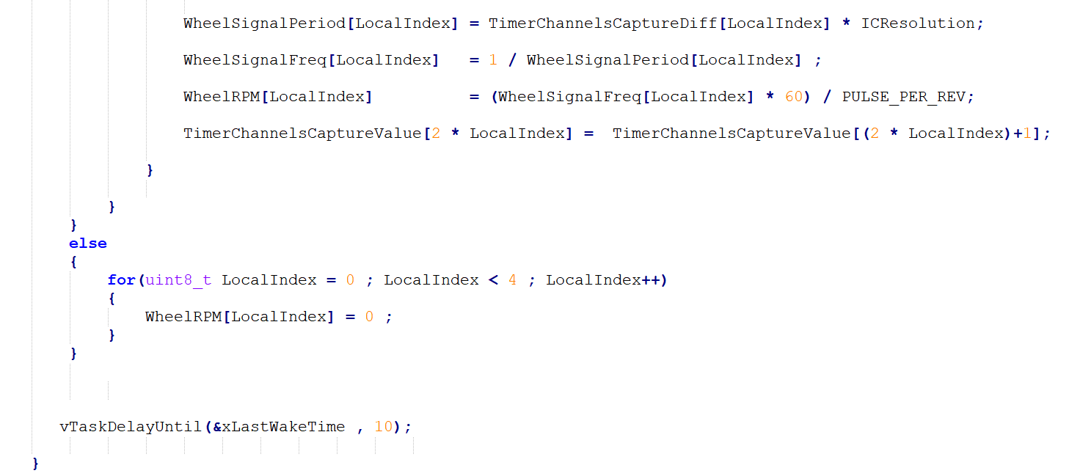

Slide 26
Error Handling

Slide 27
Thank you

